Slide 1
GANAG Lesson Plan Relationship Between Illustrations & Text
Literacy Facilitator: Krista Roth
Bonnie Grimes Elementary 2012
Kindergarten Classroom of: Kathy Chappell

Slide 2
The Purpose of the GANAG Structure
To give students the opportunity to actively use the nine high-yield strategies.
(2) Identifying Similarities and Differences
(7) Cooperative Learning
(8) Setting Objectives and Providing Feedback
(3) Summarizing and Note Taking
(4) Reinforcing Effort and Providing Recognition
(9) Generating and Testing Hypotheses
(5) Homework and Practice
(10) Cues, Questions and Advance Organizers
(6) Nonlinguistic Representations

Slide 3
Mrs. Roth and Mrs. Chappell began their planning with the unit pacing guide. They selected the standard the students were to perform.

Slide 4
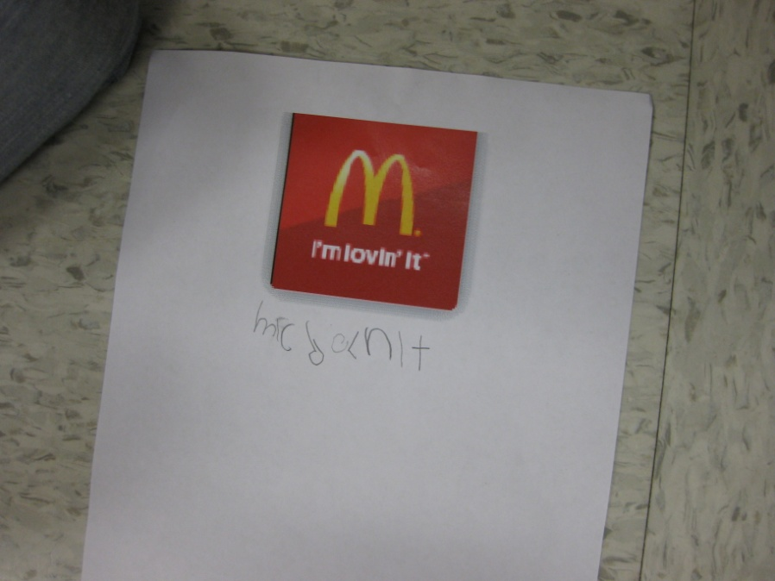
R.I.K.7
With prompting and support, describe the relationship between the illustrations and the text in which they appear (eg. Illustrations, descriptions, procedures)

Slide 5
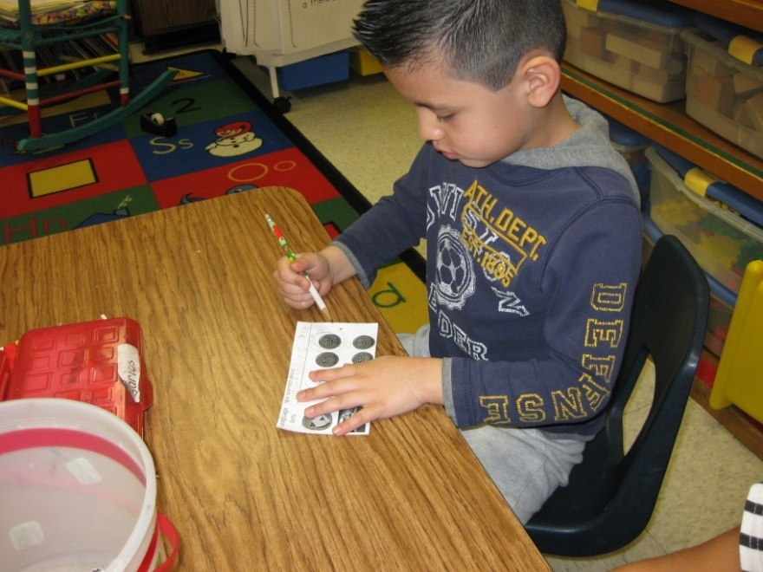
G- Goal
I can tell the relationship between illustrations and text.
Students were asked to complete their goal setting sheets.
(8) Setting Objectives and Providing Feedback

Slide 6
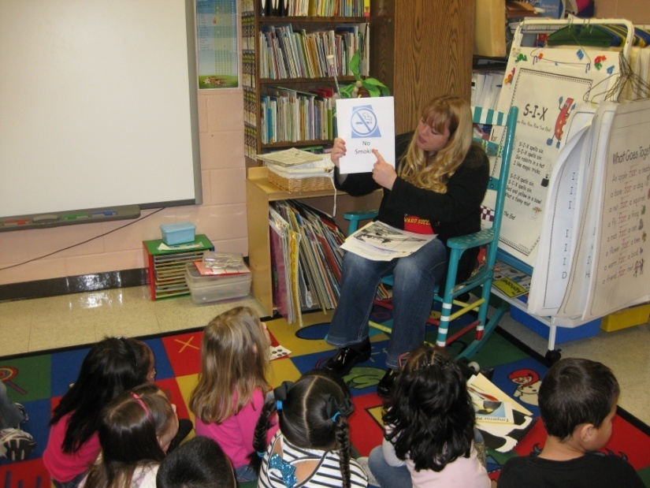
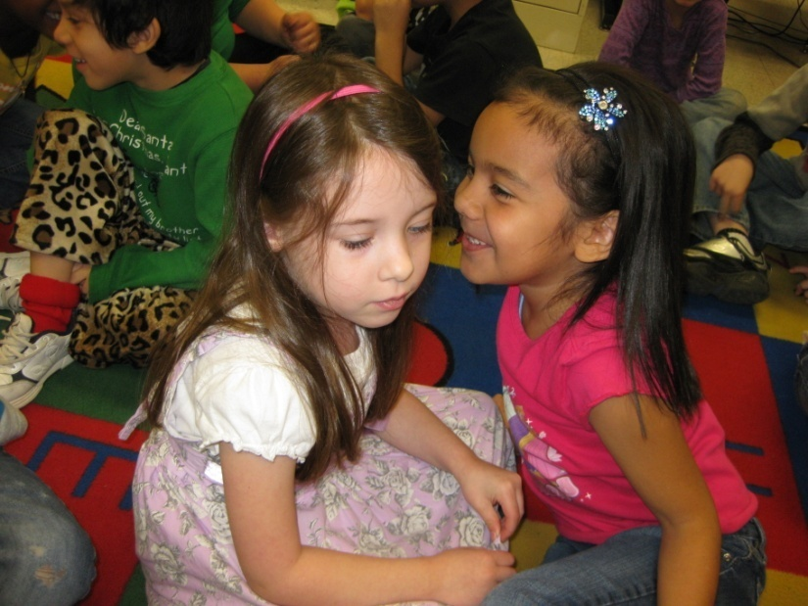
A- Access Prior Knowledge
The students observed examples of environmental print and a page of a book with illustrations and text (boys’ restroom sign with symbol, menu with text, a book with text and illustrations).
“What do you know about these?”
“Turn and talk with a partner.”
(10) Cues, Questions and Advance Organizers
(6) Nonlinguistic Representations

Slide 7
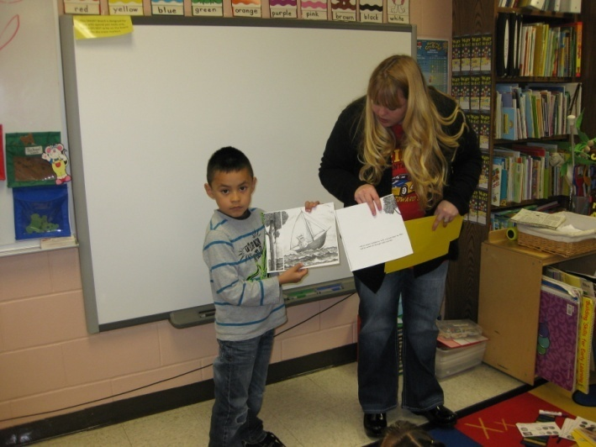
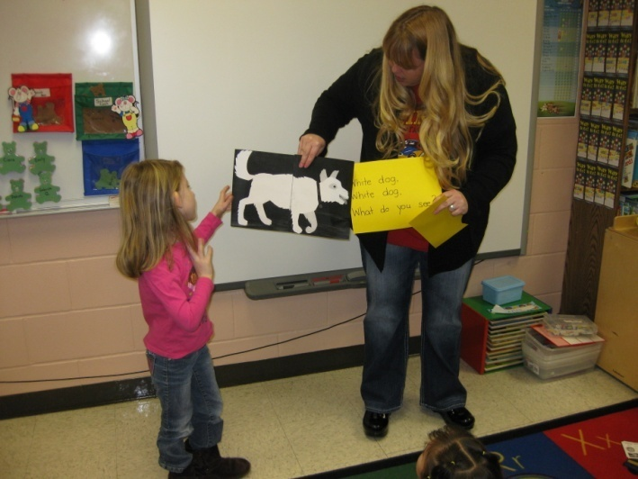
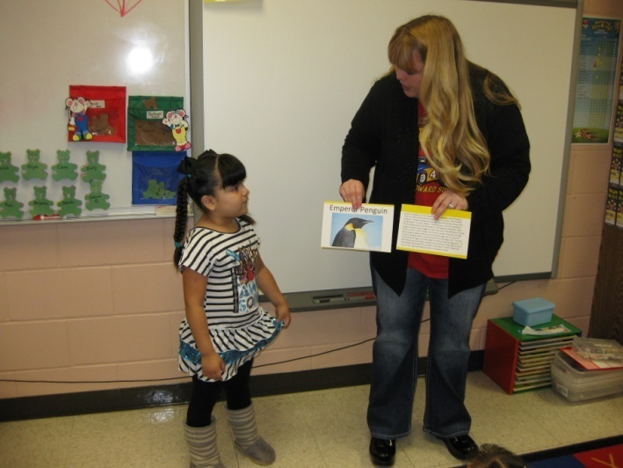
N- New Information
“Illustrations” are pictures and “text” is writing. The students observed 2 pictures of illustrations and text together. Students told the relationship between the illustrations and the text for each picture. We then matched illustrations with text (restroom sign, menu, familiar book).
“Why did the author include a picture?”
“How does the picture help the reader know what the text says?” Pair-share.
(6) Nonlinguistic Representations
(10) Cues, Questions and Advance Organizers
(4) Reinforcing Effort and Providing Recognition
(7) Cooperative Learning

Slide 9
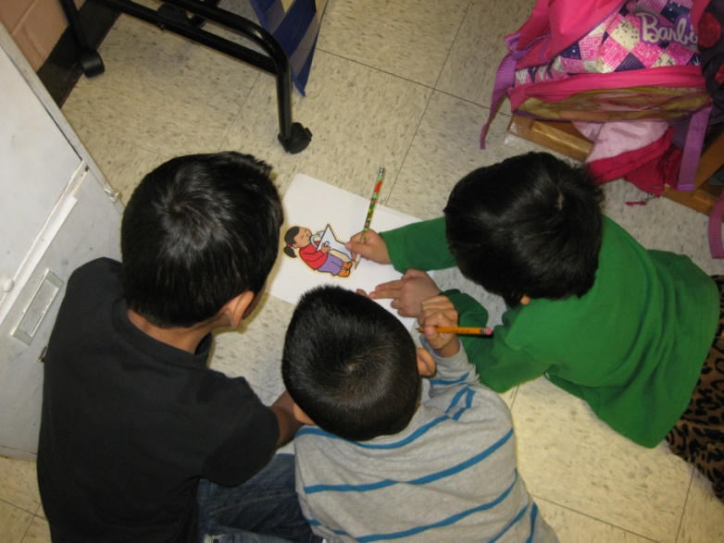
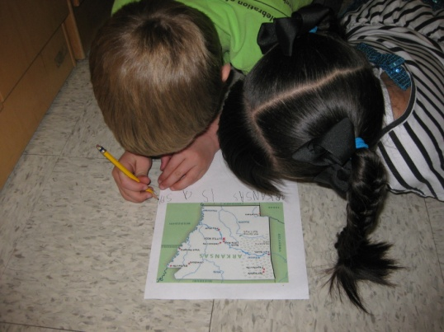
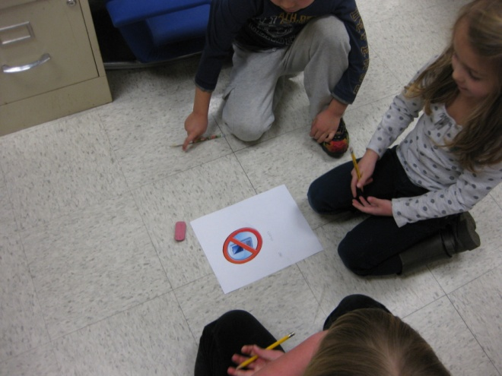
A- Application
Students worked in cooperative groups of 3 to create text to match the illustration that was given by the teacher.
(5) Homework and Practice
(7) Cooperative Learning

Slide 10
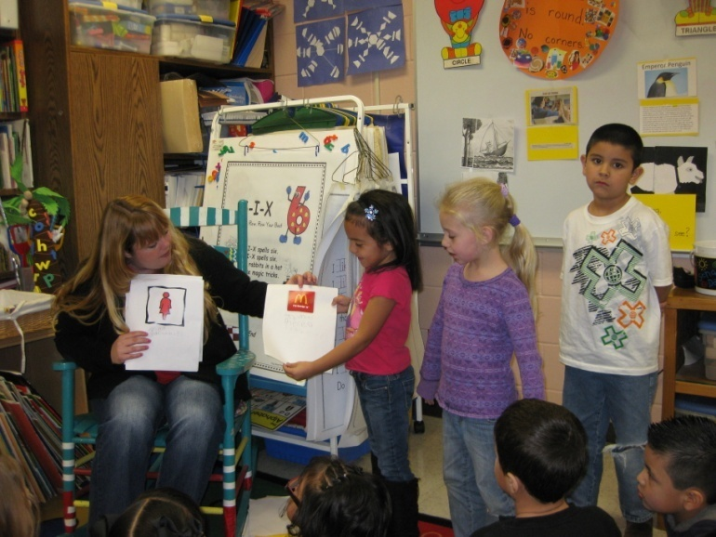
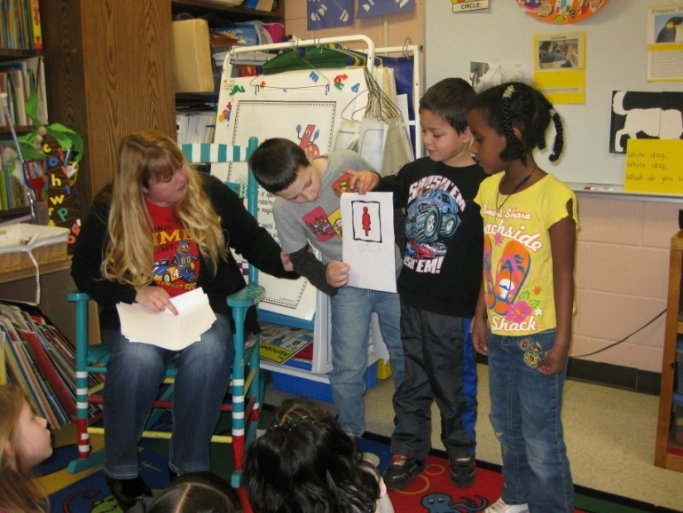
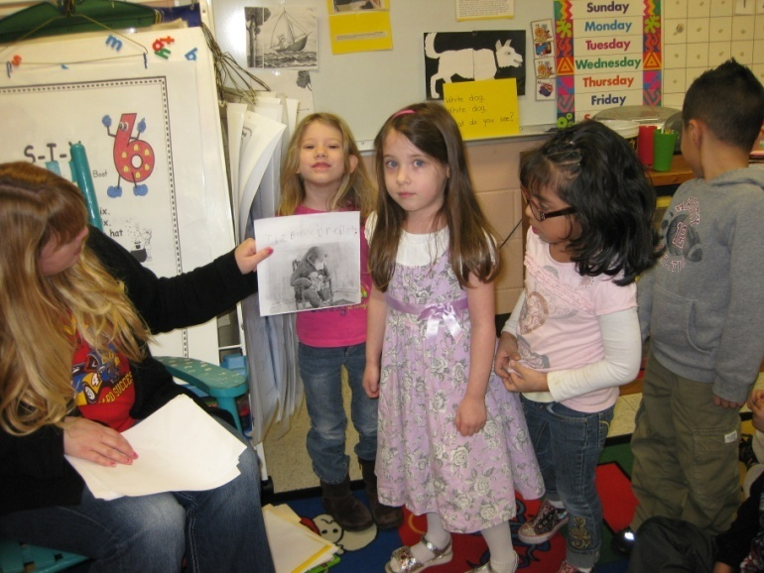
Students shared the text that they had written to match the illustrations and told the relationship between the illustrations and text.
(4) Reinforcing Effort and Providing Recognition

Slide 11
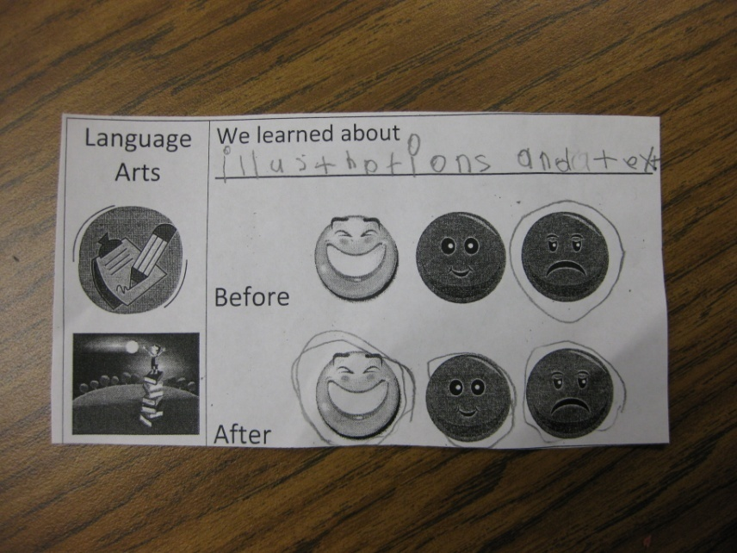
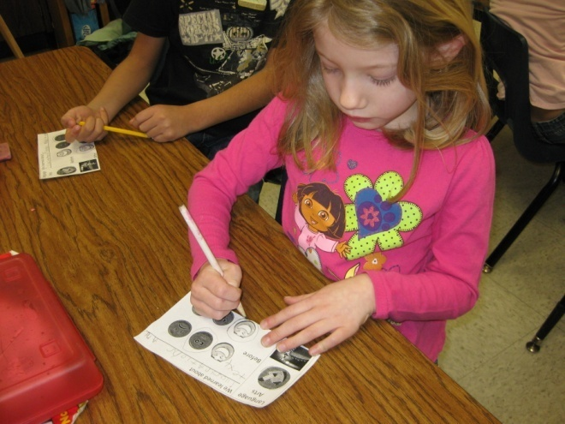
G- Revisit the Goal
“Can you tell the relationship between the illustrations and the text?”
Students completed their goal setting sheet.
(8) Setting Objectives and Providing Feedback

Slide 12
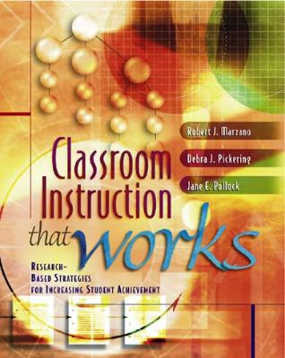
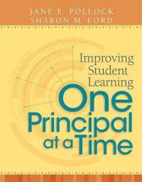
Marzano, R. J., Pickering, D. J., & Pollock, J. E. (2001). Classroom instruction that works: Research-based strategies for increasing student achievement. Alexandria, VA: Association for Supervision and Curriculum Development.
Pollock, J. E. (2007). Improving student learning one teacher at a time. Alexandria, VA: Association for Supervision and Curriculum Development.
Pollock, J. E., & Ford, Sharon M. (2009). Improving student learning one principal at a time. Alexandria, VA: Association for Supervision and Curriculum Development.

